Slide 1
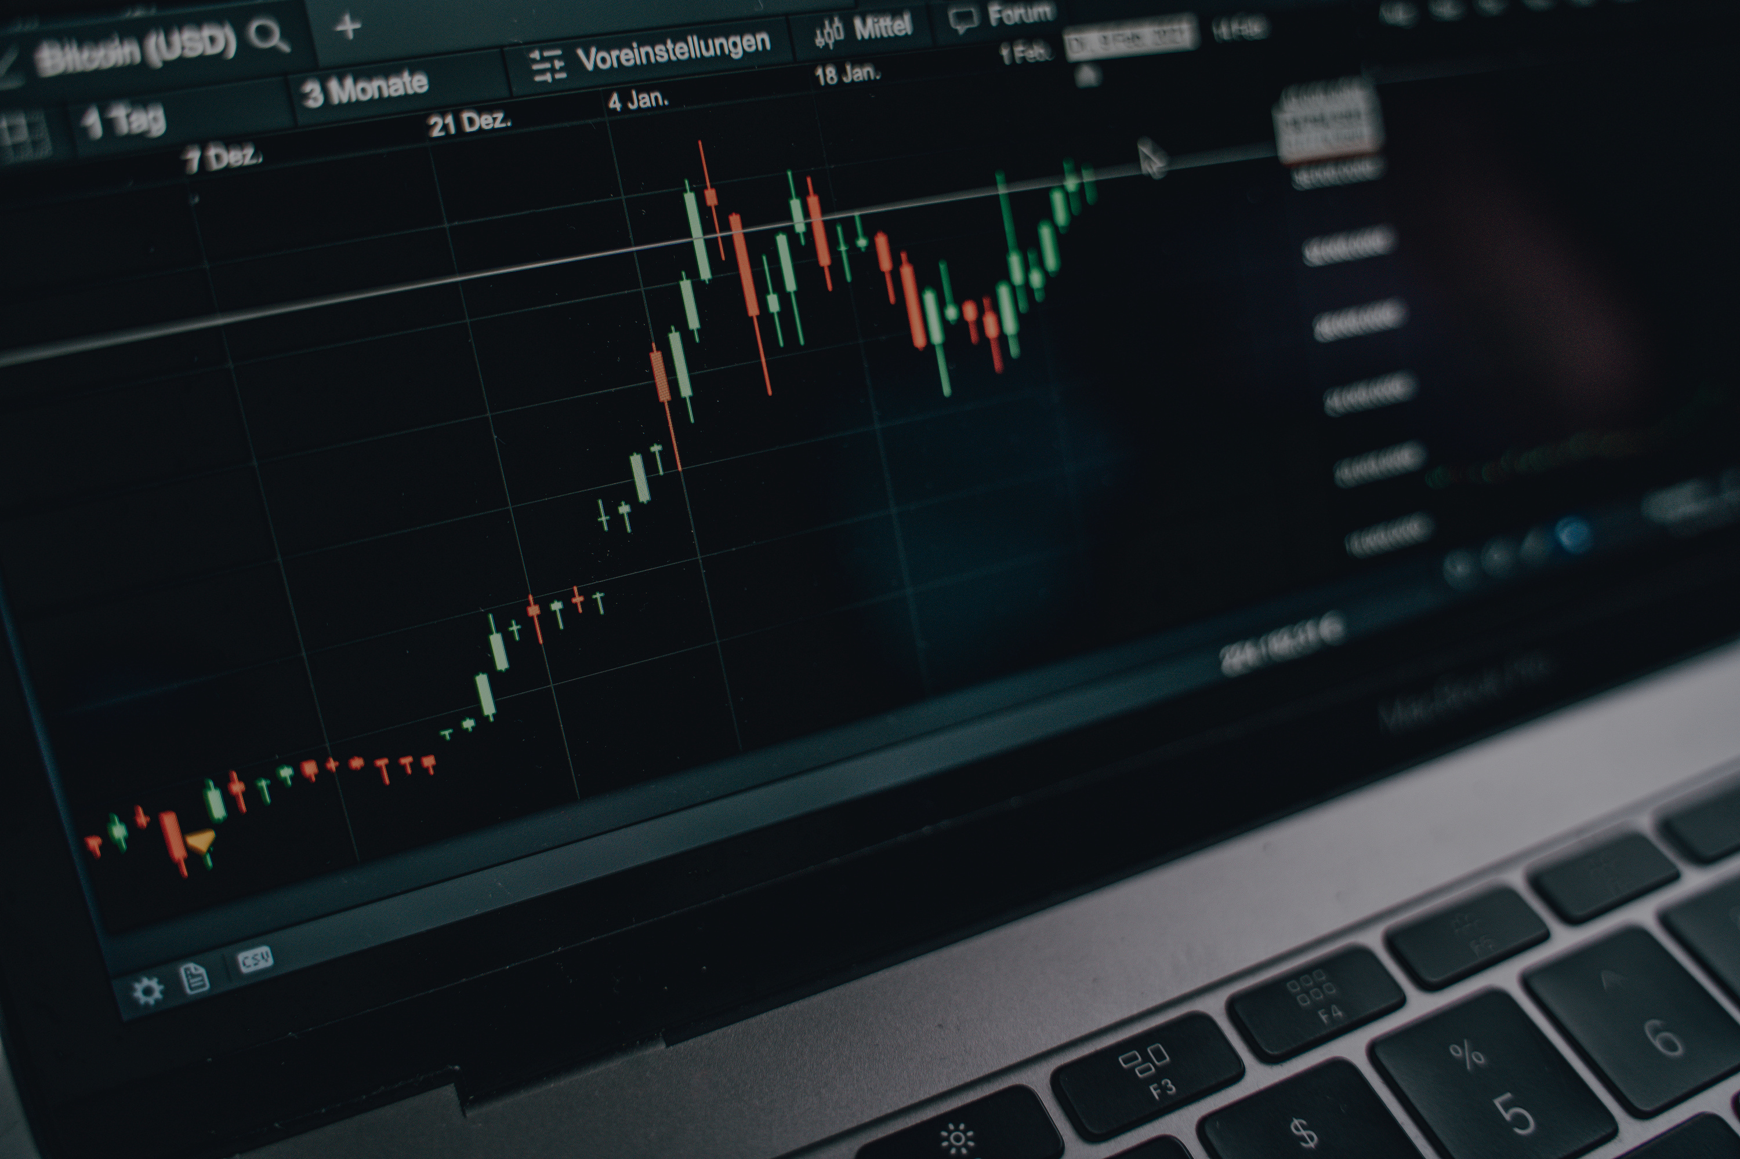

MOMENTUM OF
SWINGS IN INSIGHTS
Swing Trading: A Strategic Approach to Capitalize on Market Movements
Why Swing Trading Outperforms Other Methods
Presented by: MEETH KAWAD
RAYUDU NIKHITHA
HANEEF
HARI KIRAN

Slide 2
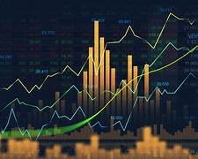
SWING TRADING
INTRODUCTION TO SWING TRADING
  What is Swing Trading?
    Definition: Swing trading is a strategy where positions are held from one day to several months to capture short- to medium-term price movements known as "swings."
    The aim is to identify and profit from significant price fluctuations, such as a stock moving from ₹140 to ₹210.
    Example: A trader buys a stock at ₹160 and aims to sell at ₹200 to capture the ₹40 price movement, avoiding the full volatility of day trading and the long commitment of investing.
  Why Swing Trading?
    Potential for Higher Returns: By focusing on price fluctuations, traders can generate significant returns over a relatively short period.
    Time Flexibility: Unlike day trading, swing trading allows more flexibility in monitoring positions, suitable for those with other commitments.

Slide 3
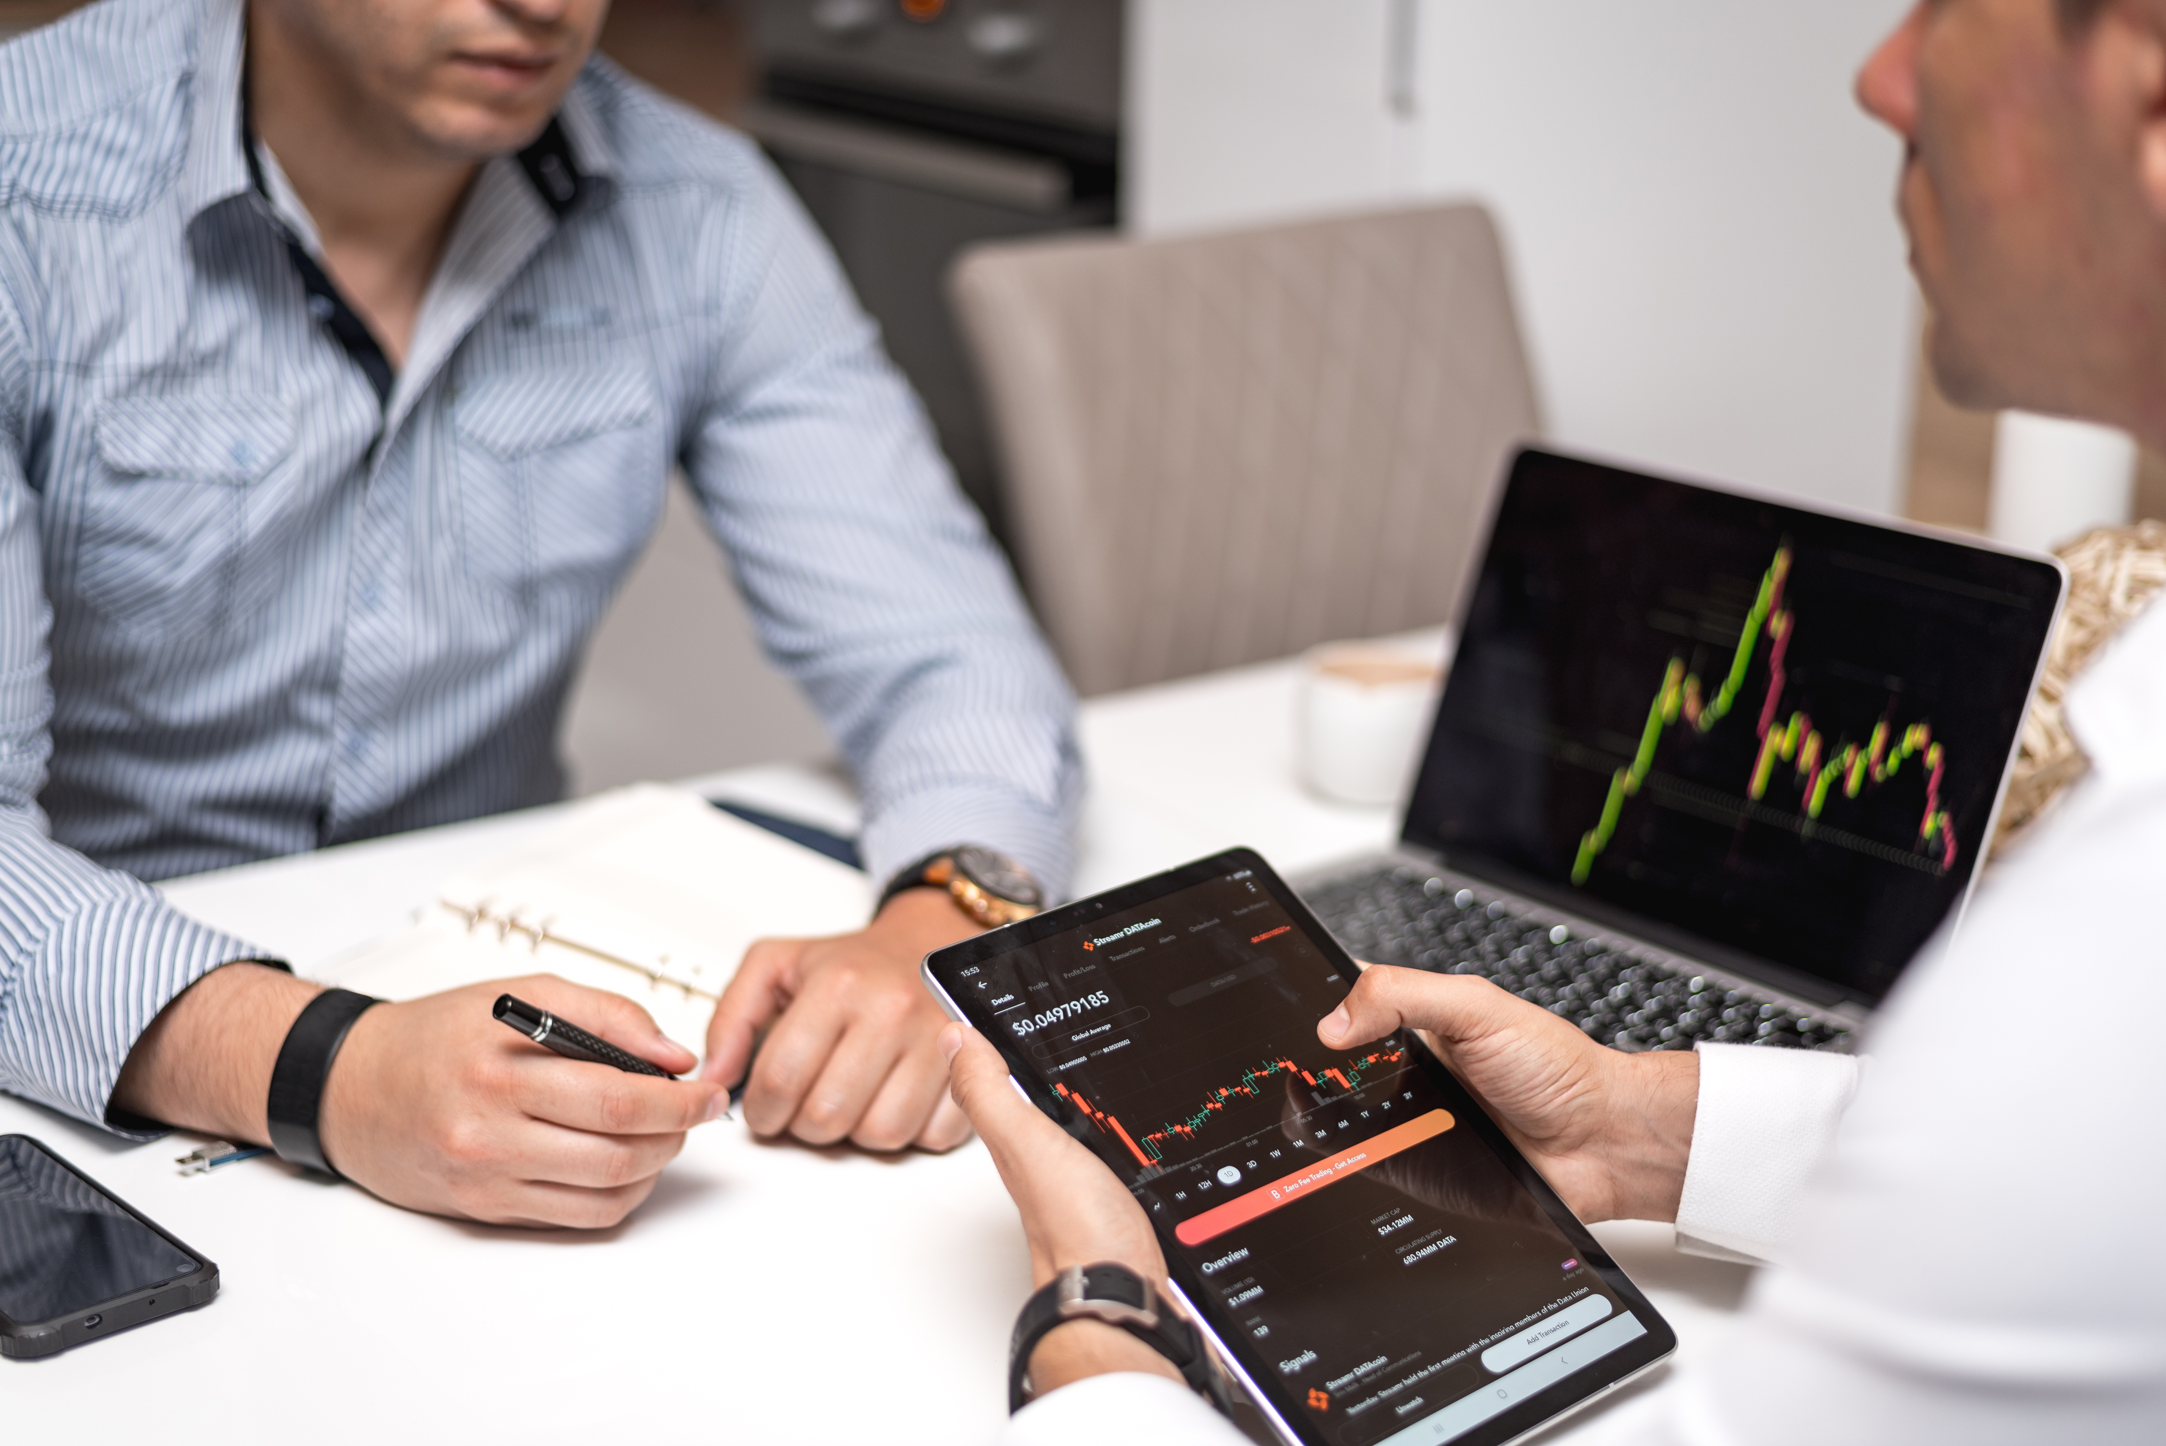
WHY CHOOSE SWING TRADING?
CRYPTO COIN
DAY TRADING
LONG-TERM INVESTING
MUTUAL FUNDS
ADVANTAGES OF SWING TRADING:
  Requires constant monitoring of the market.
  Trades are executed quickly, which can lead to higher stress levels and emotional decisions.
  Not ideal for those who cannot monitor the market full-time.
  Focuses on buying and holding stocks for years, making it less profitable in the short term.
  Slower growth compared to swing trading, which captures medium-term price swings.
  Lower control over individual stock choices, as the investment is pooled with others.
  Generally offers steady, less volatile returns compared to actively managing a portfolio of swing trades.
  Balance of Risk and Reward:
  Risk per trade is limited to 2%-3% of the total portfolio, while aiming for a 1:3 risk-reward ratio.
  This means that for every ₹1 of risk, the potential profit is ₹3.
  More Predictable than day trading: Swing traders rely on technical analysis and fundamental data to inform their strategy, reducing emotional decision-making.

Slide 4
KEY INDICATORS IN SWING TRADING
01
TECHNICAL INDICATORS:
02
FUNDAMENTAL INDICATORS:
  Exponential Moving Average (EMA):
    Tracks the average price of a stock over a certain period but gives more weight to recent prices, making it more sensitive to recent price changes.
    20-period and 5-period EMAs are commonly used to identify trends and entry/exit points.
  Simple Moving Average (SMA):
    Similar to EMA but gives equal weight to all periods. It’s used to confirm the trend direction.
  Stochastic Momentum Index (SMI):
    Measures momentum by comparing closing prices to a stock’s price range over a given period.
    SMI Parameters: Typically set to 7, 3, 3, 7, used to identify overbought or oversold conditions.
  Heikin-Ashi Candlestick Patterns:
    Modified candlesticks used to make trend patterns clearer by smoothing price action, especially on daily charts.
  Market Capitalization (Market Cap):
  Measures a company's size and helps identify stable stocks for long-term investment.
  P/E Ratio:
  Helps assess whether a stock is overvalued or undervalued relative to its earnings. A P/E ratio between 20-25 is generally considered fair for growth stocks.
  ROE (Return on Equity) & ROCE (Return on Capital Employed):
  These indicators help evaluate a company’s efficiency in generating profits from its resources.
  Dividend Yield & Book Value:
  High Dividend Yield can signal stable companies but may indicate low growth potential if too high.
  Book Value helps assess intrinsic value to check if the stock is undervalued.

Slide 5
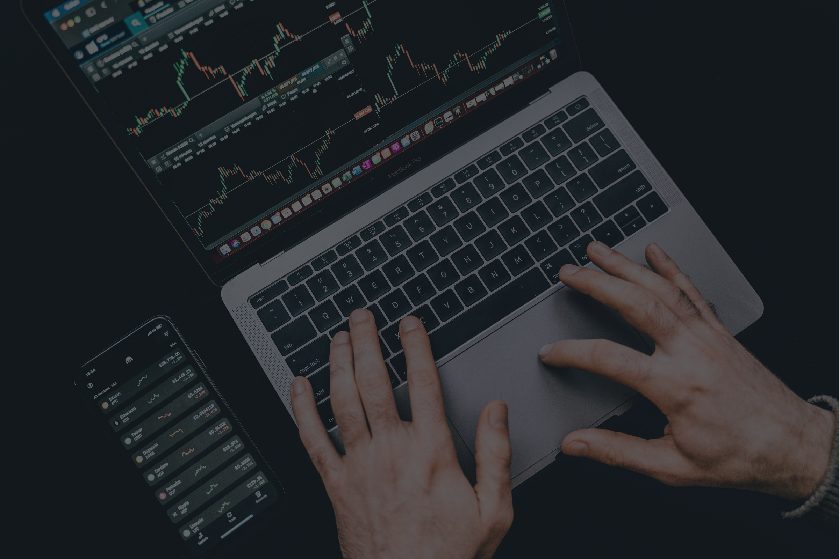


ADVANTAGES OF USING SWING TRADING OVER OTHER INVESTMENTS
  High Return Potential:
  By capitalizing on short-term price fluctuations, swing traders can achieve significant profits within weeks or months.
  Stocks offer higher volatility and potential for returns compared to mutual funds, which often have a conservative approach.
  Risk Management:
  Swing trading uses a defined risk-reward ratio (1:3) and limits the exposure of the total capital (2%-3% per trade).
  This helps preserve capital even in case of occasional losses, unlike long-term investing which exposes the portfolio to more prolonged downturns.
  Flexibility & Time Commitment:
  Swing trading offers more flexibility than day trading. Traders don’t need to monitor the market continuously.
  It allows part-time traders to make informed decisions based on technical and fundamental analysis without being glued to the screen.
  Diversification:
  Swing trading can involve both individual stocks for higher returns and indexes for more stability.
  This approach provides broader market exposure and reduces risk through diversification.
REALLYGREATSITE.COM

Slide 6
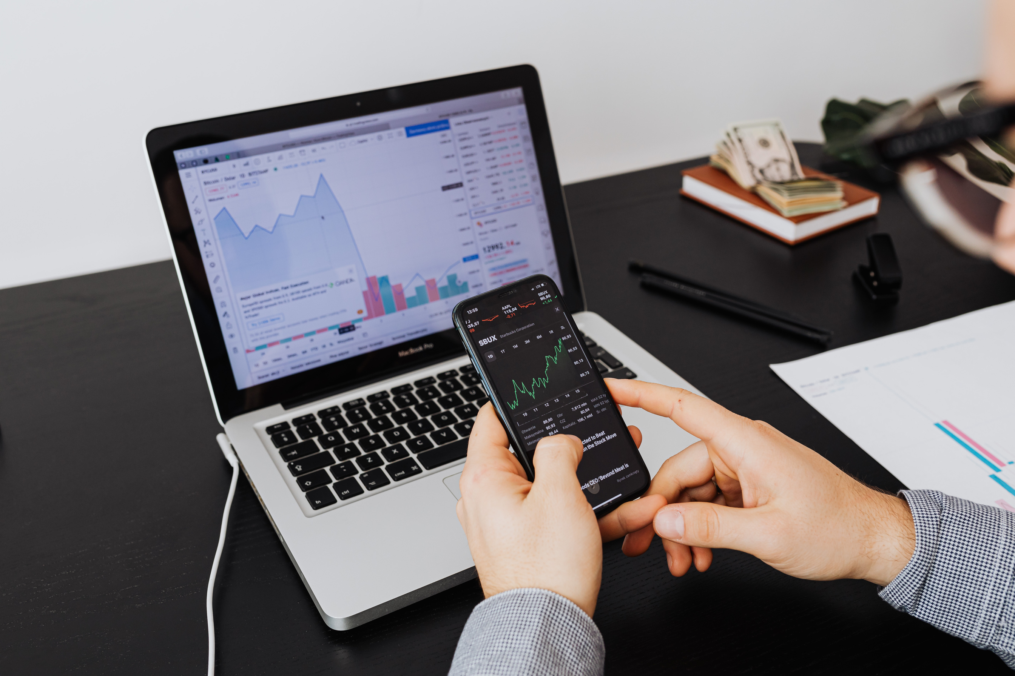
TECHNICAL & FUNDAMENTAL ANALYSIS IN SWING TRADING
01
TECHNICAL ANALYSIS:
  Relies on tools like EMA, SMA, and SMI to predict future price movements.
  Indicators help identify trends, reversals, and overbought/oversold conditions.
  Heikin-Ashi Candles provide clearer trend signals by reducing market noise.
02
FUNDAMENTAL ANALYSIS:
    Helps assess the intrinsic value of stocks using market cap, P/E ratio, and profitability metrics (ROE, ROCE).
    Selecting stocks with solid financials helps ensure long-term growth potential.
    Key metrics like dividend yield and book value are used to confirm the stock's underlying financial health.
$. 608.00.896.789.900
+23487.09
$. 708.006.789.859.77
-13487.09
$. 567.345.678.123.
-487.09

Slide 7
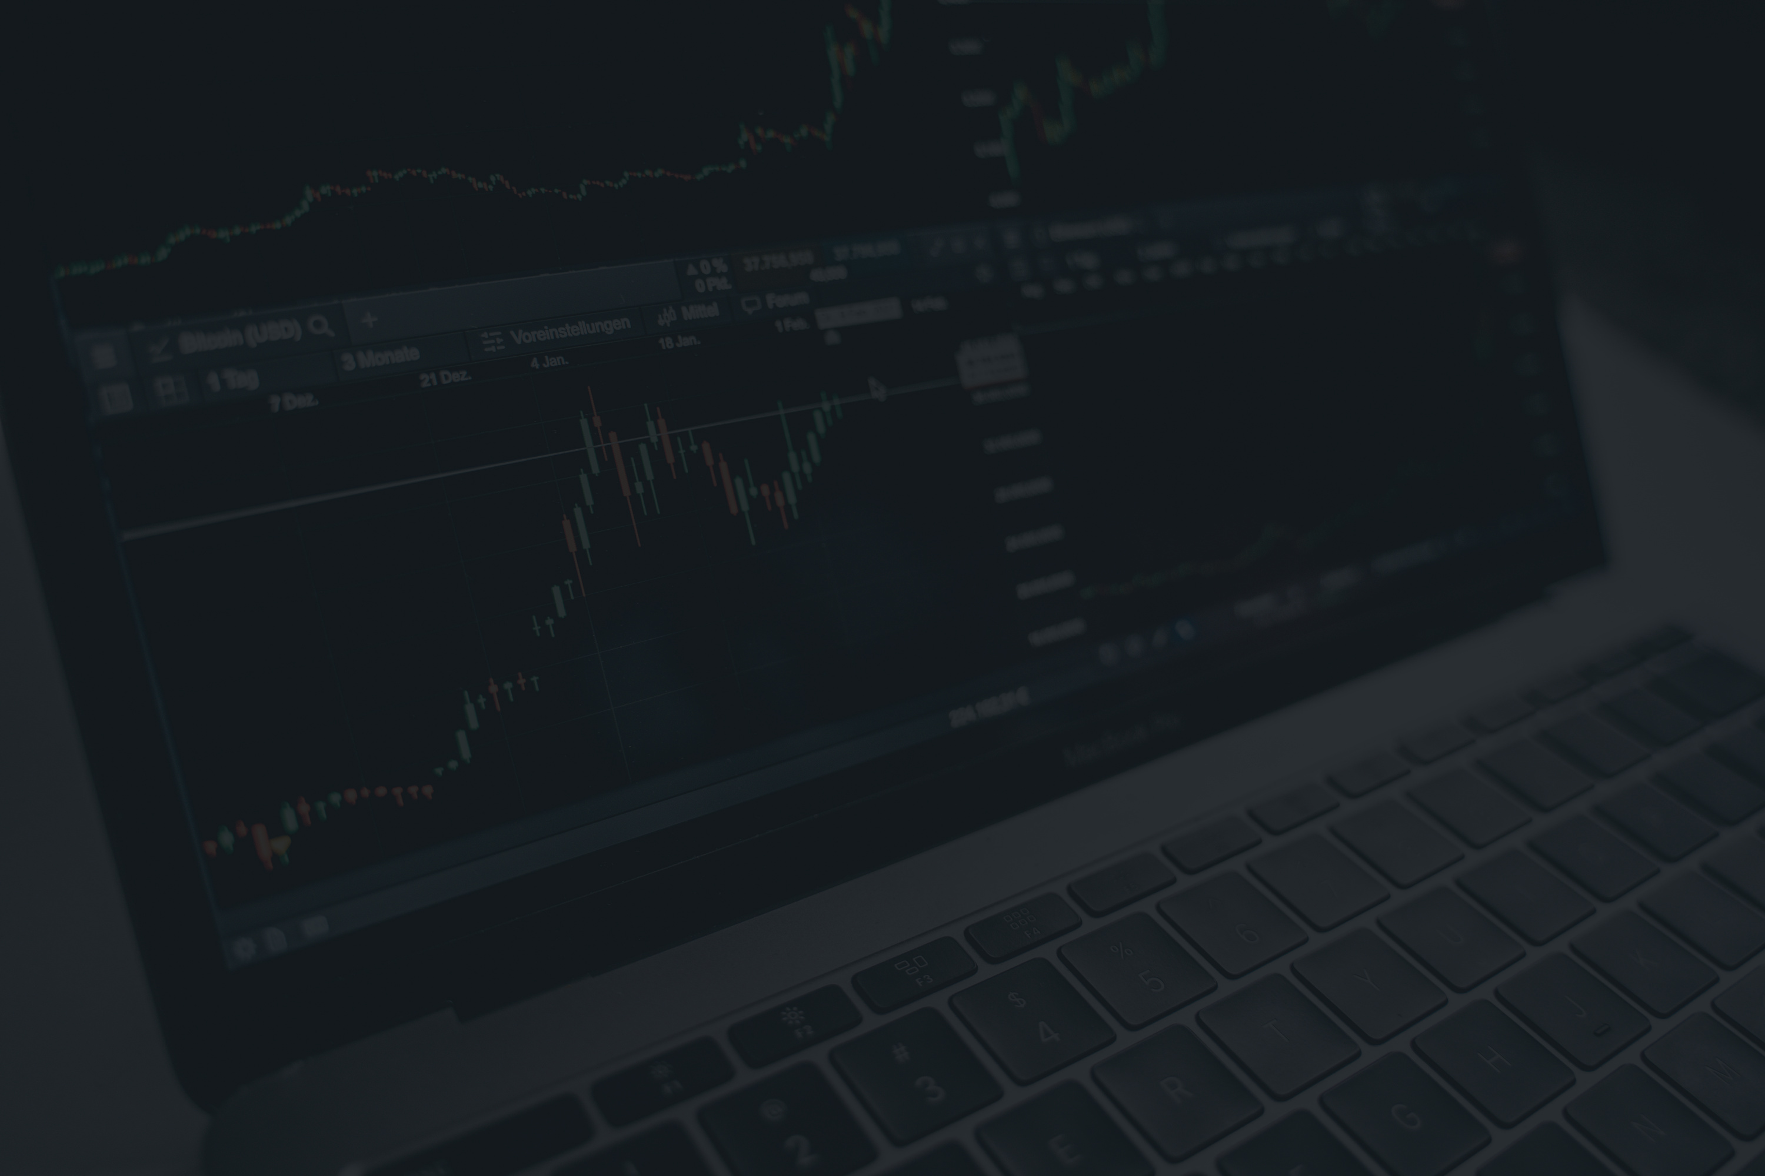
RISK MANAGEMENT IN SWING TRADING
RISK PER TRADE:
RISK-REWARD RATIO:
LIMITING EXPOSURE:
EACH TRADE SHOULD RISK ONLY 2%-3% OF THE TOTAL PORTFOLIO. THIS HELPS IN MANAGING OVERALL RISK WHILE STILL CAPITALIZING ON PROFITABLE OPPORTUNITIES.
MAINTAIN A 1:3 RATIO: FOR EVERY ₹1 RISKED, AIM FOR ₹3 IN PROFIT.
THIS ENSURES THAT A SMALL NUMBER OF SUCCESSFUL TRADES CAN MORE THAN OFFSET LOSSES FROM UNSUCCESSFUL TRADES.
BY KEEPING RISK PER TRADE LOW AND DIVERSIFYING ACROSS STOCKS AND INDEXES, THE IMPACT OF A LOSS IS MINIMIZED.

Slide 8
CRYPTO COIN
HOW PYTHON & MACHINE LEARNING ENHANCE SWING TRADING
AUTOMATION
MACHINE LEARNING:
  Using Python, technical and fundamental data can be analyzed automatically, reducing manual effort.
  Python can automate trade signals, such as buying when specific conditions are met (e.g., EMA crossover, SMI overbought signal).
  Python can incorporate machine learning algorithms to predict market movements based on historical patterns.
  Data-driven decisions: Machine learning helps improve predictions, identify profitable patterns, and optimize strategies.

Slide 9
COMPARISON: SWING TRADING VS. OTHER INVESTMENT STRATEGIES
  SWING TRADING OFFERS A BALANCED APPROACH WITH FLEXIBILITY AND HIGH RETURN POTENTIAL.
  COMPARED TO DAY TRADING, IT’S LESS STRESSFUL AND OFFERS MORE TIME FOR ANALYSIS.
  UNLIKE LONG-TERM INVESTING, IT PROVIDES HIGHER RETURNS OVER A SHORT PERIOD WITH CONTROLLED RISKS.
Method | Risk | Return Potential | Flexibility | Time Commitment
Swing Trading | Low to Moderate | High | High | Moderate
Day Trading | High | High | Very Low | Very High
Long-Term Investing | Low | Moderate | Low | Very Low
Mutual Funds | Low | Moderate to Low | Low | Low
VISION STATEMENT

Slide 10
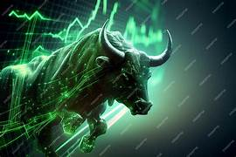
BACKTESTING & STRATEGY VALIDATION
BACKTESTING
VALIDATION
  Simulate trades on historical data to check how well the strategy would have performed.
  Metrics to track: ROI (Return on Investment), Sharpe Ratio (risk-adjusted return), win rate, and profit/loss consistency.
  Use paper trading to validate the strategy before committing real capital.
  Refine execution based on performance in the real market.

Slide 11
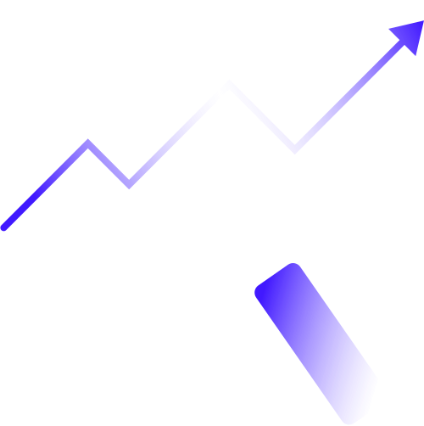


Conclusion
  Swing Trading is a balanced, profitable strategy that combines technical and fundamental analysis for making informed decisions.
  Key Advantages:
  Higher returns, lower risk, and more flexibility compared to other methods.
  Python and machine learning enhance decision-making and increase trading efficiency.
  Recommendation: Swing trading is suitable for traders who want to engage in active trading without the need for constant market monitoring.

Slide 12
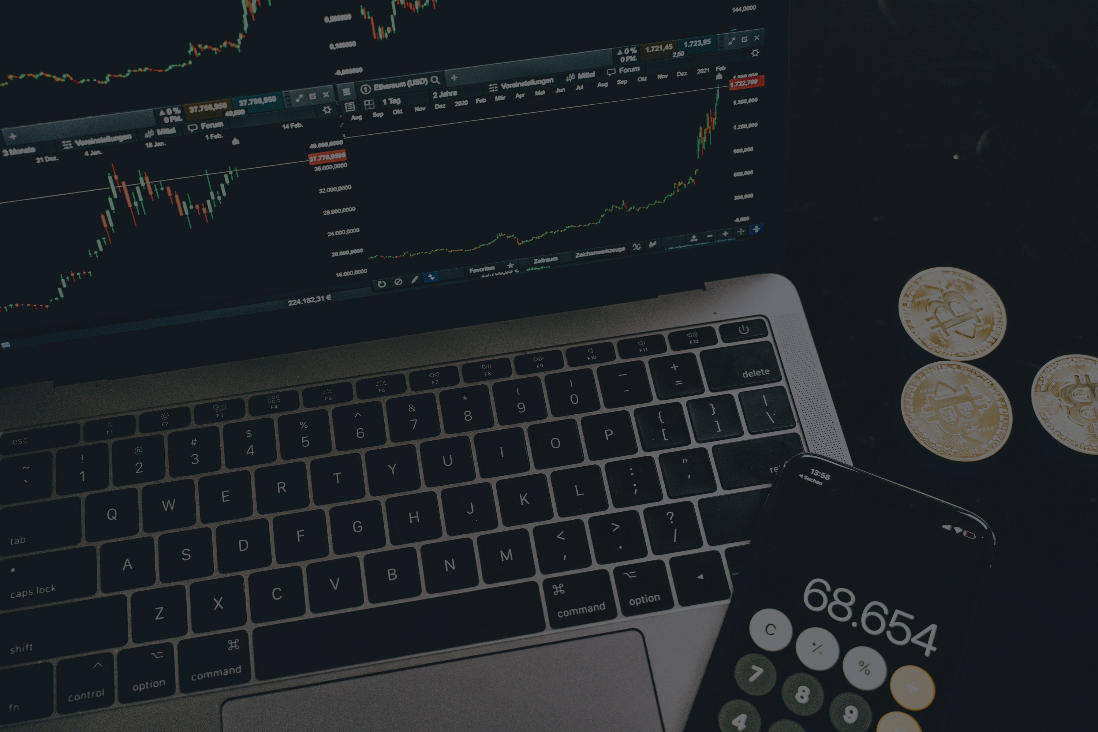
CRYPTO COIN
THANK
YOU

